Slide 1
Money Manager Application
Prepared By:
TARUNMUTHU CS (212103276) AVINASH S (212103217) BHARATH RAJ S T (212103219)
Under The Guidance of :-
Mr. Kirubakaran M.C.A.,M.Phil.

Slide 2
1
PROJECT DEFINITION

Slide 3
The project is based on finance management. Our app is used to manage budget and expenses.
The app tracks monthly and yearly finance record.
It helps to invest in future to make life easier.
Save money and be rich in future

Slide 4
2
INTRODUCTION

Slide 5
The “Money Manager Application” has been developed to override the problems prevailing in the practicing of the finance problems.
This software is supported to eliminate and in some cases reduce the hardships faced by this existing system. Moreover this system is designed for the particular need of the company to carry out operations in a smooth and effective manner. Thus this application provides the required information in less time and also helps in quicker decision making.

Slide 6
The main purpose of this App is manage money in easy and proper way .
In this app we are providing month and year wise budget management.
In this app we are spent money in clothes, education, charity, House expenses, Entertainment, etc. So all the cost are counting and minus this cost from providing budget.
After the remaining amount are invest in good area for better future.
This app mainly help in manage money and invest money in good stuff.

Slide 7
3
OBJECTIVES OF THIS SYSTEM

Slide 8
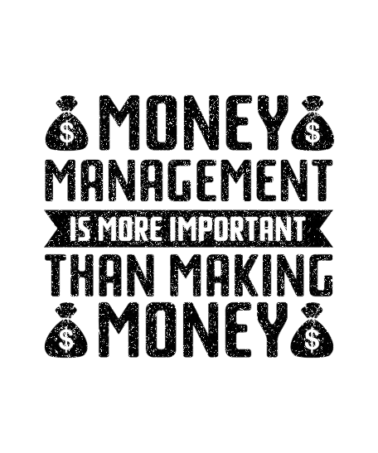
A Money Manager app helps create financial stability by tracking expenses and following a plan, a budget makes it easier to pay bills on time, build an emergency fund, and save for major expenses such as a car or home. Overall, a budget puts a person on stronger financial footing for both the day-to-day and the long term.

Slide 9
4
CURRENT SYSTEM AND SCOPE OF THE SYSTEM

Slide 10
Current System
Calculate monthly and yearly expenses.
Show data through graph
Date-time of every budget expense
Category wise managing budget

Slide 11
Scope Of The System
Be easy to understand by the user.
Be easy to operate.
Have a good user interface.
Be expandable.
Delivered on schedule within the budget.

Slide 12
5
FUTURE ENHANCEMENT

Slide 13
Utilization of current code with adding further function required.
Can link up with Bank.
Manually entry not required, It will be directly reflecting amount.

Slide 14
6
LIMITATIONS

Slide 15
Inflexible: A budget is formed depending on certain policies of an institution or goals of an individual that leads to decision-making. However, if there is any need to review the financial status considering any change in the market there is no way the budget can be altered.
Finance oriented: The budget does not support the interests and requirements of the people. It is more profit-oriented which is more quantitative while the needs of the people are more qualitative in nature.
Time-consuming: The process of planning a budget Or budgeting is a time-consuming affair. It needs to consider all possible aspects of an organization or an individual before ensuring any expenditure or spending towards a particular goal.
Conflicts: The failure of a budget plan can result in a lot of arising tensions and rifts within the company that ultimately get reflected by the inefficient running of the organization

Slide 16
7
HARDWARE AND SOFTWARE SPECIFICATIONS

Slide 17
Software :
Hardware :
Android Operating System.
Android minimum version Android 5.0 Lollipop.
For developing app we are using android studio and for database we are using SQLite.
Android Based Smart phone
Minimum 2 GB RAM required.
App size space required in ROM.

Slide 18
FLOW CHART
8
Fig:-8 System Flow Chart

Slide 19
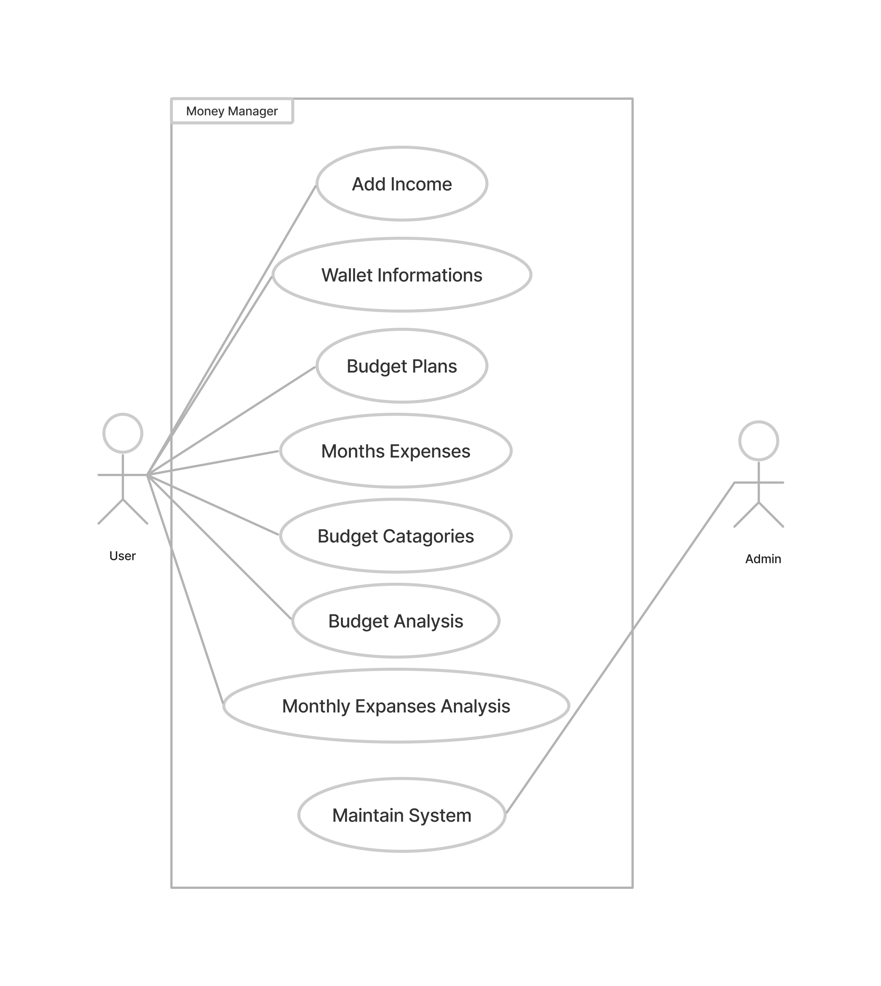
USE CASE DIAGRAM
9
Fig:-9 Use Case Diagram

Slide 20
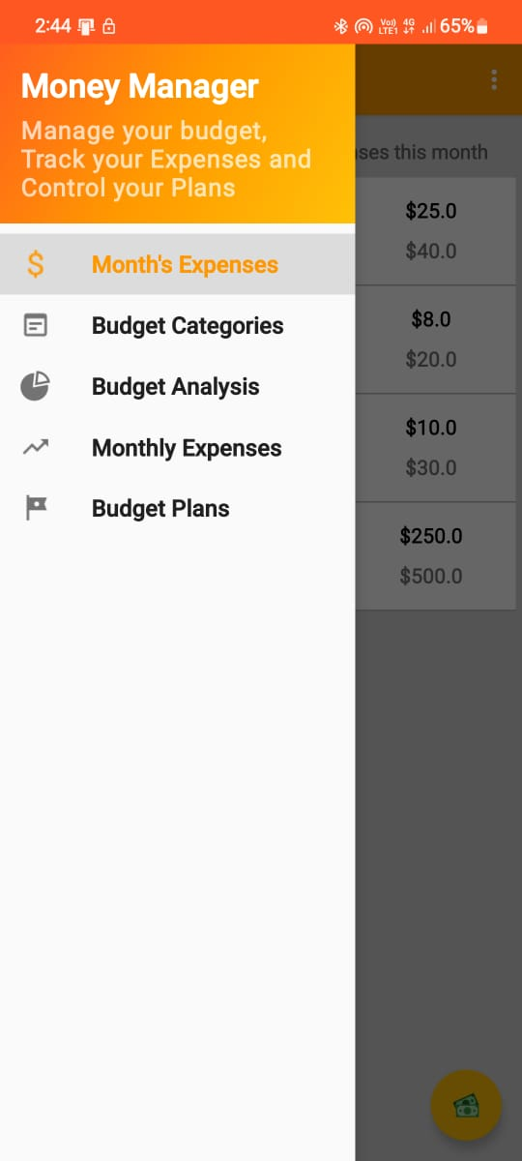
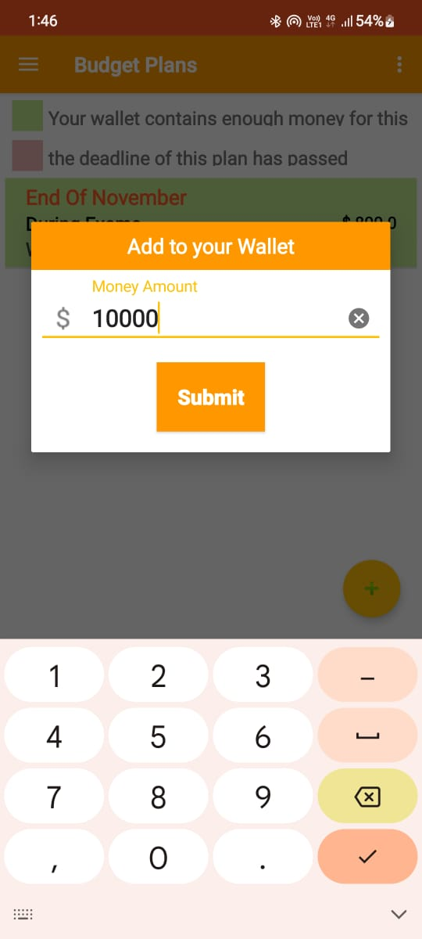
OUTPUT
10
Fig:-10.1 Menu Bar
Fig:-10.2 Add Income In Wallet

Slide 21
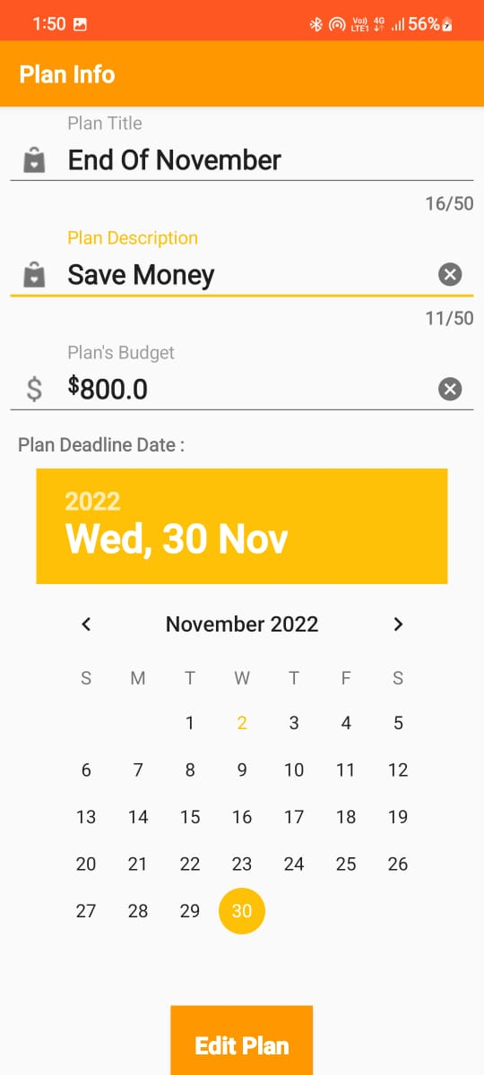
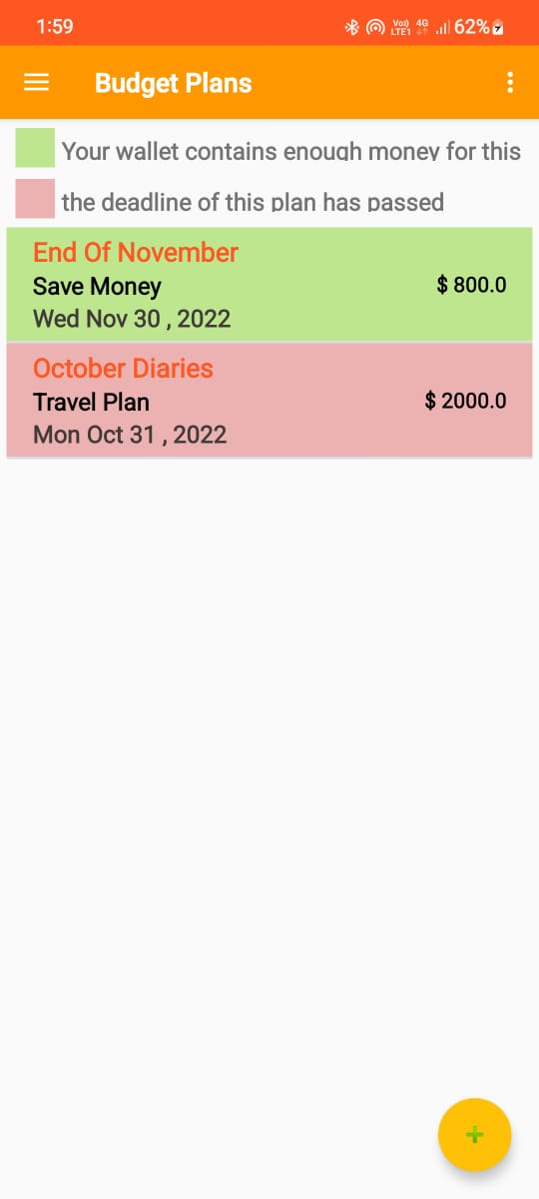
OUTPUT
10
Fig-10.3 Add Plan
Fig-10.4 Budget Plans

Slide 22
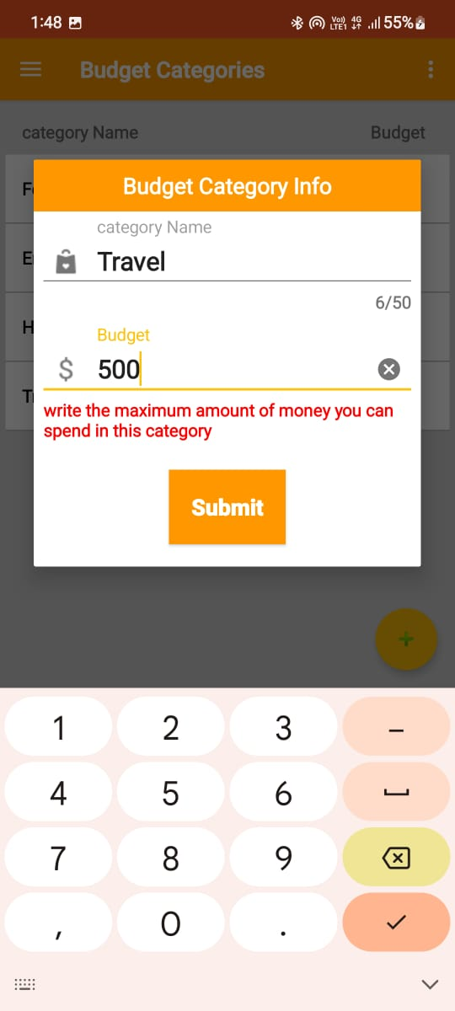
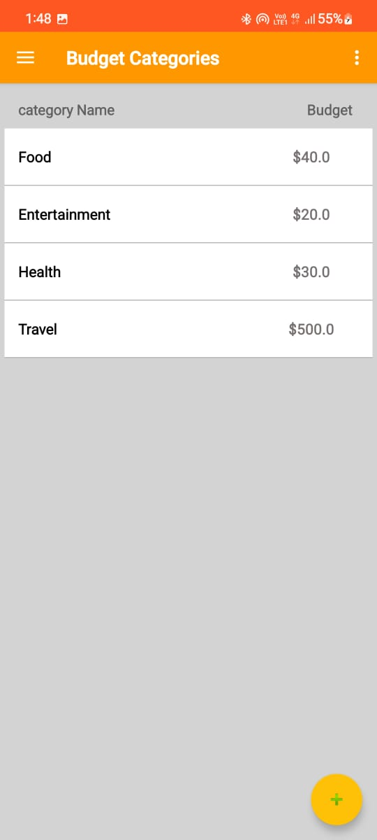
OUTPUT
10
Fig-10.5 Add/Edit Categories
Fig-10.6 Budget Categories

Slide 23
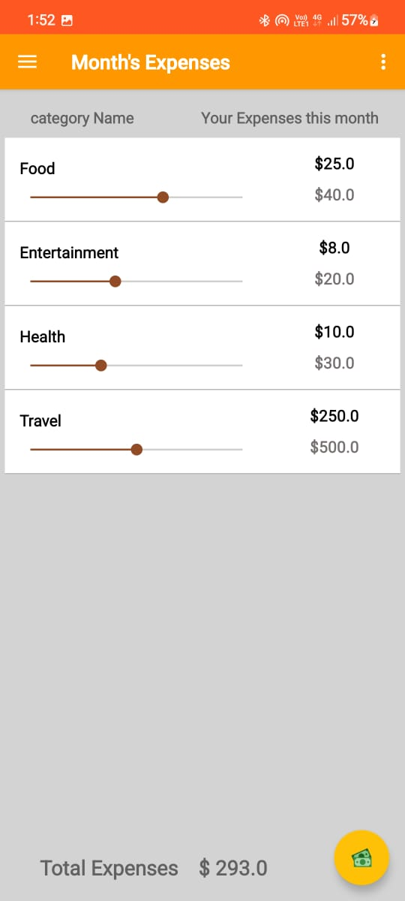
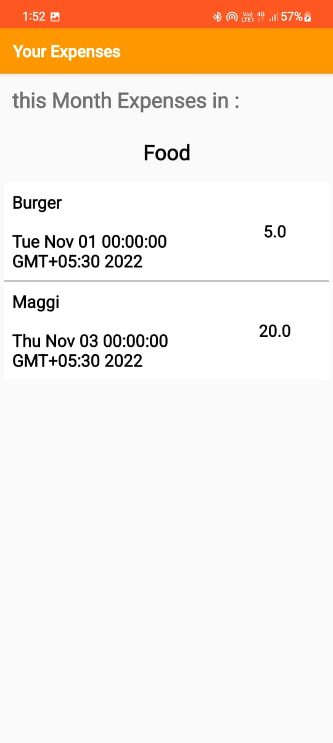
OUTPUT
10
Fig-10.7 Category Wise Monthly Expense
Fig-10.8 Monthly Expense

Slide 24
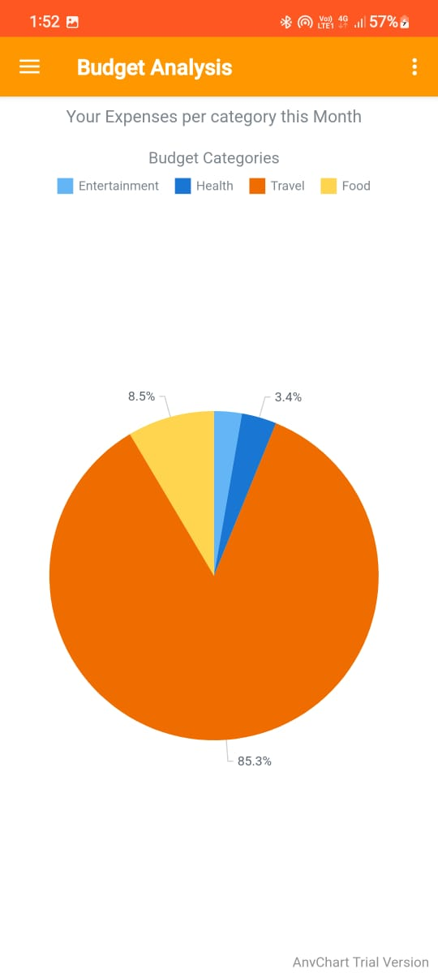
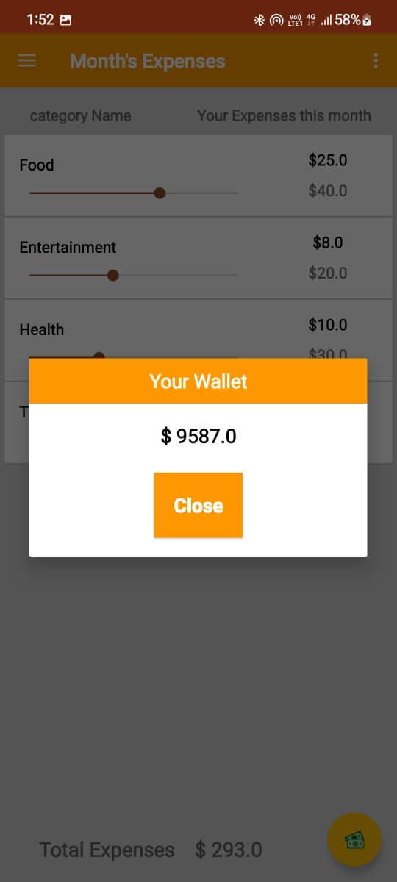
OUTPUT
10
Fig-10.9 Budget Analysis
Fig:-10.10 Remaining Wallet

Slide 25
GANTT CHART
11
Research and Analysis
July
August
September
October
November
Designing
July
August
September
October
November
Implementing
July
August
September
October
November
Testing
July
August
September
October
November

Slide 26
12
CONCLUSION

Slide 27
Developing a money manager and tracking all expenses and spending is a crucial aspect of finances. Set aside a fixed amount in a savings account, they say you should always have three months work of your living expenses in a savings account in case of emergencies. Lastly, educating the children early in life about finances should be a mandatory class in every school. Parents need to proactive in teaching their children about banking, credit card, interest rates, and credit. The importance of actually seeing my spending on my budget sheet was enlightening. Learn management of money and make future bright.

Slide 28
13
REFERENCES
https://www.investopedia.com/terms/m/moneymanager.asp
https://apps.apple.com/us/app/money-manager-expense-budget
https://www.youtube.com/watch?v=dZ5aCGr26Q8
https://www.gadgets360.com/apps/ money-management-finances-budget
https://www.google.com/search?q=money+management+app
https://play.google.com/store/apps/details.application. wallet

Slide 29

THANK YOU

